Slide 1



Electrical & Electronics Engineering Department
EE493 - Engineering Design I
“Cısss!”
Lambda
Shareholders:
Berk Erhan Yüksel
Necdet Can Sönmez
Mustafa Barış Emektar
Alper Saraç
Furkan İtkü

Slide 2
Outline
Company Introduction
Problem Statement
System Requirements & Objectives
Design Process & Solution Approach
Detection Subsystem
Control Subsystem
Alerting Subsystem
Test Plans (Prototype Photo)
Management
Conclusion

Slide 3
Company Introduction
Lambda Company was established in October 2021 at METU, Ankara.
Mission
To provide innovative, reliable products and energy-efficient solutions in the field
of electronics and system integration, and to make people's lives easier with the
projects it produces.
Innovative
Technological Development
Creative
Reliable
Energy-efficient
Environmentally
Human-friendly
Vision
To be a reliable, innovative, environmentally and human-friendly technology company that maintains its sustainable growth with the values it creates.

Slide 4





Company Introduction
Our company consists of 5 engineers who are specialized and experienced in various fields.
Berk Erhan Yüksel
- Signal Processing
- Algorithm Design
- Matlab, C/C++
Necdet Can Sönmez
- Computer
- Embedded Systems
- Python, C/C++
Mustafa Barış Emektar
- Computer
- Embedded Systems
- C/C++
- 3D Modeling & Design
Alper Saraç
- Computer
- Embedded Systems
- Python, C/C++/C#
Furkan İtkü
- Computer
- Embedded Systems
- Matlab, C/C++

Slide 5
Problem Statement
Design and construct a device to help keep pets away from designated locations.
Control a pet’s behavior around the house.
“Cısss!”

Slide 6
Problem Statement
Master Unit
Detect the pet when pet is approaching forbidden areas
In case of violation of forbidden areas, the main unit should warn the pet.
The device will consist of two types of units:
A single mobile (wearable) smart “MASTER” unit.
Several (as many as necessary) identical “TAGS”.
Tags
Placed in designated forbidden zones
Area tags should be for the detection of the pet’s entry into an area or doorway

Slide 7
System Requirements & Objectives
Functional Requirements
Detect the pet when pet approaches forbidden areas (Zone)
Detect the pet when pet goes through the door (Doorway)
Sense four different distance ranges to warn the pet in four stages of increasing alarm strength
Warn the pet with electrical, mechanical, or acoustic stimulus, these warnings should not be harmful.
Performance Requirements
The distance between the two door sills should be a minimum of 90 cm.

Slide 8
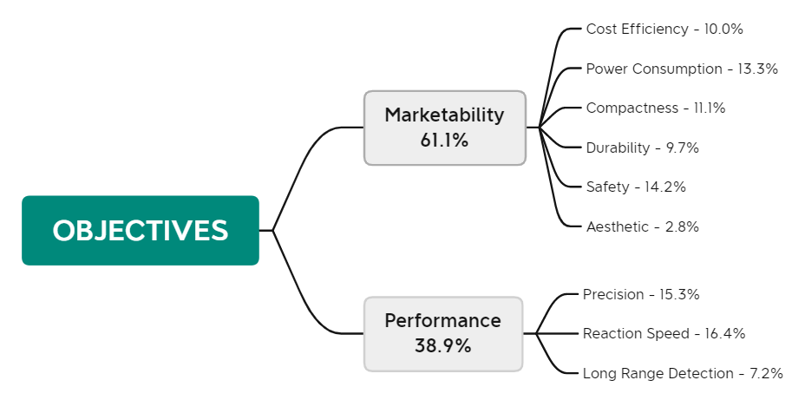
System Requirements & Objectives
The team members agreed on several project objectives, which were then compared to determine the overall weight of each democratically.
Figure 1: Objectives Tree

Slide 9
System Requirements & Objectives
For example,
The system should warn the pet at most 1 sec, if the pet crosses predefined boundary.
Both the master unit and the tags should be able to be powered with a single-button battery, which will be able to keep it powered up for at least 2 weeks.
The system should not be affected in cases where it passes by the door, it should work robustly.
There is no metric for the stability of the project, but the system needs to be as stable as possible. For robustness, system needs some filters or algorithms. (Kalman, Trilateration Method…)
The dimensions of the master unit must be at most 20cm x 15cm x 7 cm.
(The product's shape can vary; it does not have to be a rectangular prism.)
Since the device's wearer is a pet, it should not weigh over 100-150 grams.

Slide 10

Design Process & Solution Approach
Overall System (Block Diagram)
Detection Subsystem
Control Subsystem
Alerting Subsystem

Slide 11
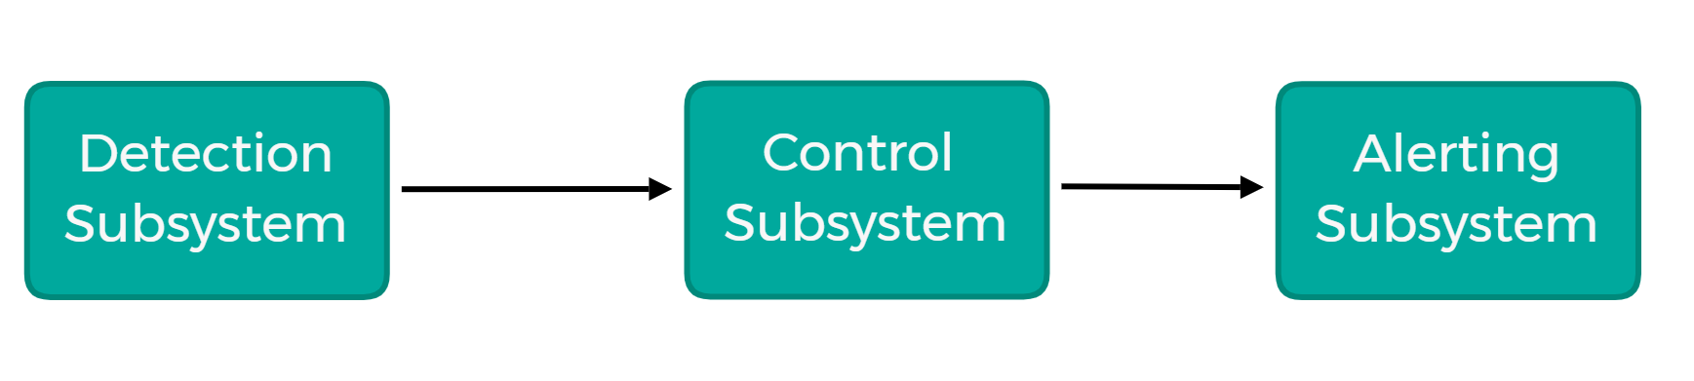
Overall System
Figure 2: Block Diagram of the Overall System

Slide 12
Detection Subsystem
Core subsystem of the project.
Measurements should be correlated with distance.
Should operate robustly.
Precision of the measurements should be good enough.

Slide 13
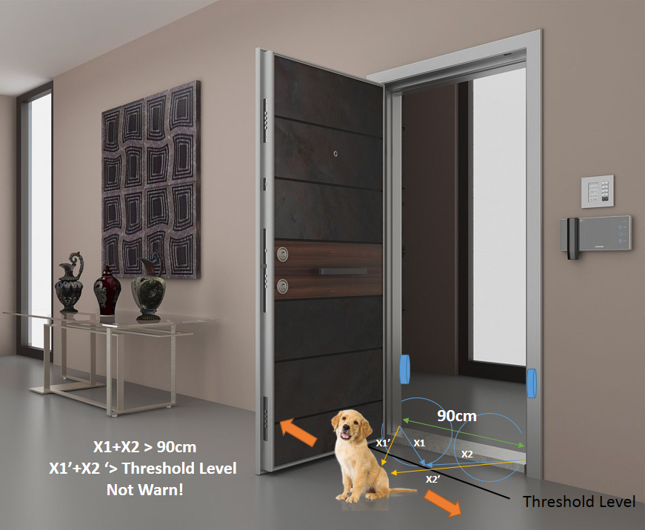
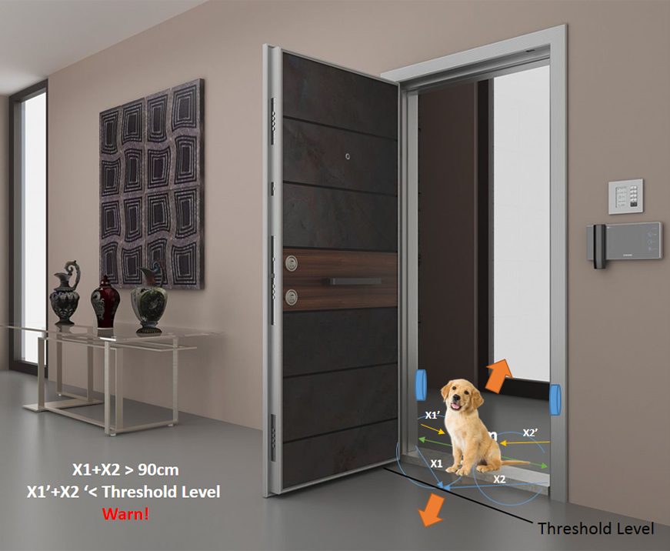
Door Tag
Figure 3: Door Tag Explanation

Slide 14
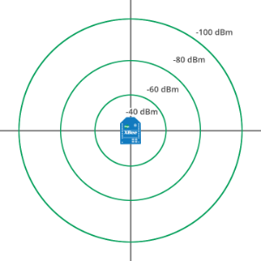
Plan A: RSSI Measurement Using RF
RF communication in 2.4 GHz is used.
Tag receives signal from master unit.
Tag responds with another signal.
Master units receives this signal and measure its RSSI value.
Figure 4: A Simple Demonstration of the RSSI Technic

Slide 15
Plan A: RSSI Measurement Using RF
Converting the RSSI to distance depends on environmental parameters.
Magnetization sensor can be used.
Angle dependency needs to be handled
Different antenna can be used

Slide 16

Plan B: RSSI Measurement Using Bluetooth Protocol
Microcontroller used for this project supports Bluetooth Low Energy.
Power of the received packet may be stored more accurately.
More tests should be done to reach a conclusion about this approach.

Slide 17

Plan C: Time of Flight Measurement Using Ultrasonic Sound
ToF based approach in an electromagnetic wave based system is not allowable.
As a solution, sound can be used.
Main Disadvantages:
They reflect off objects at much higher rates.
Sound waves travel at different speeds through different media.

Slide 18

Control Subsystem
Hardware used
Main structure of the program
Filtering process

Slide 19
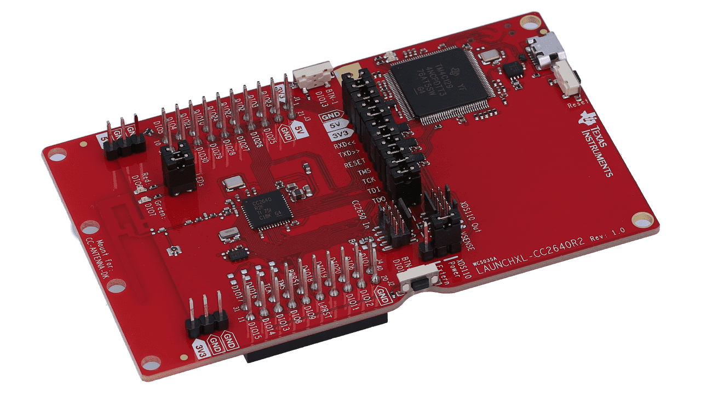
Figure 5:TI LAUNCHXL-CC2640R2

Slide 20
Main structure of the program
TI’s open-source operating system (written in C) is used, which is abstracted away with C++
Object-oriented programming approach is used (e.g. on-board LEDs are abstracted as a class)
RF transceiving capabilities are abstracted as a class, with master and tag being classes of a child of that class
Master seeks the tag, who sends an acknowledgment signal back to the master; master processes the RSSI to estimate distance

Slide 21
LTA (Long Term Average) Method
y_{t}=x_{t}*(1/f)+y_{t-1}*(1-(1/f))
Is a basic implementation of a low-pass filter to remove noise
Filter strength depends on filter factor
Higher filter factor gives better filter strength but reduces reaction speed, and vice versa
Filter factor can be changed during operation, dynamic
Works real-time, i.e. achieves oversampling with a processing frequency equal to sampling frequency

Slide 22
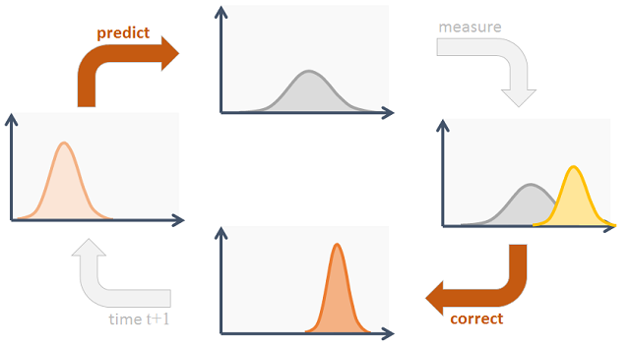
What is a Kalman filter?
x_{t}=A_{t}x_{t-1}+B_{t}u_{t}+e_{t} & z_{t}=C_{t}x_{t}+d_{t}
A Kalman filter uses the previous state, as well as the “uncertainty” in the system to “predict” which state the system will be in next
“Kalman gain” dictates how much we will depend on our measurement and how much on the previous state
Kalman gain is updated every cycle according to the uncertainty, which is a metric of how much error there is in the system

Slide 23
Our implementation of a Kalman filter
We assume that the device does not move (u_{t} = 0) and that RSSI is constant when there is no motion (A_{t} = 1)
Furthermore, we equate our states to our measurements (C_{t} = 1)
We assume that the variance of the RSSI is correlated directly to uncertainty, and Kalman gain correlated inversely to uncertainty
k_{t}=1/(1+var_{t}) & y_{t}=(1-k_{t})y_{t-1}+k_{t}x_{t}
The result is a watered-down version of a Kalman filter, incorporating the theory into an LTA filter to remedy low reaction speed

Slide 24
Log-distance pathloss model
RSSI=-10n*log(d/d₀)+A₀
n is the signal propagation exponent, depends on the environment
A₀ is the RSSI value at d₀
Using this, we can find a “raw distance” value that we can pass through the Kalman filter to compute our estimated distance
Estimated distance can be used to find the level of proximity, which is then used to light up the on-board LEDs accordingly

Slide 25

Alerting Subsystem
Using a Buzzer Module
Using a Speaker
Using Vibration
Using an LED

Slide 26
Test Cases
Control
Chipboard Obstruction
Non-uniform Metal Object Obstruction
90° Angled
180° Angled

Slide 27
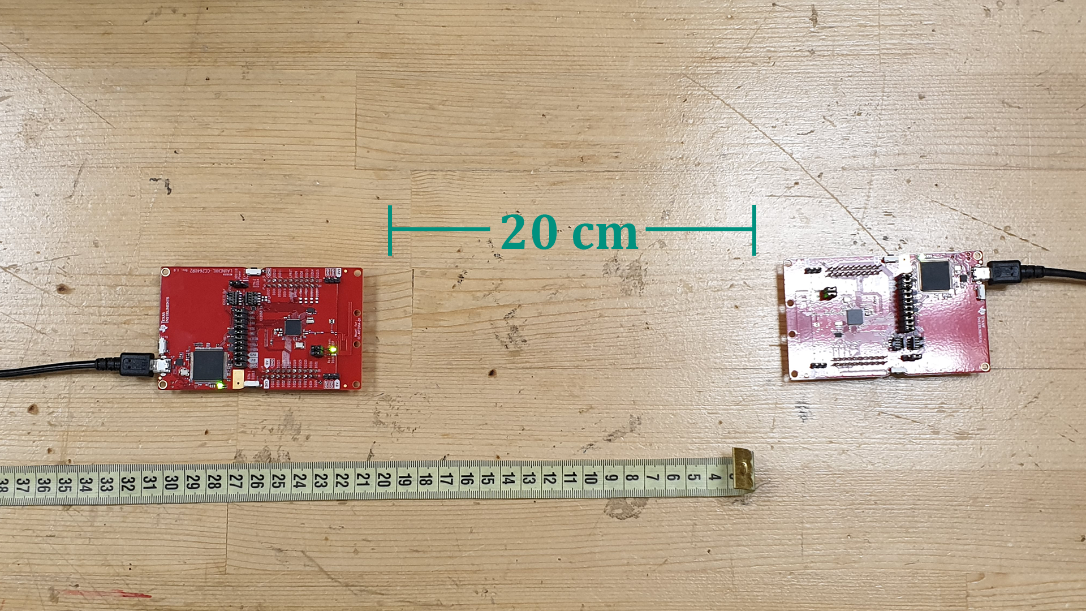
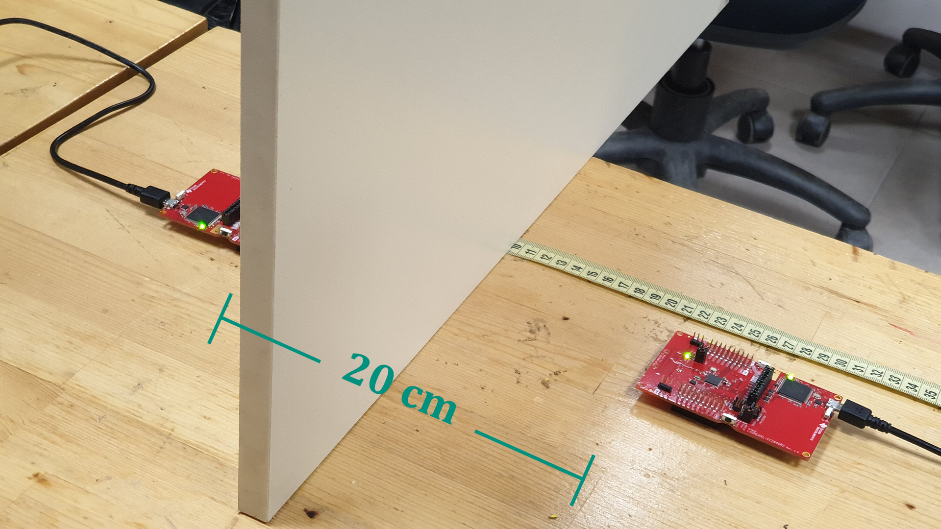
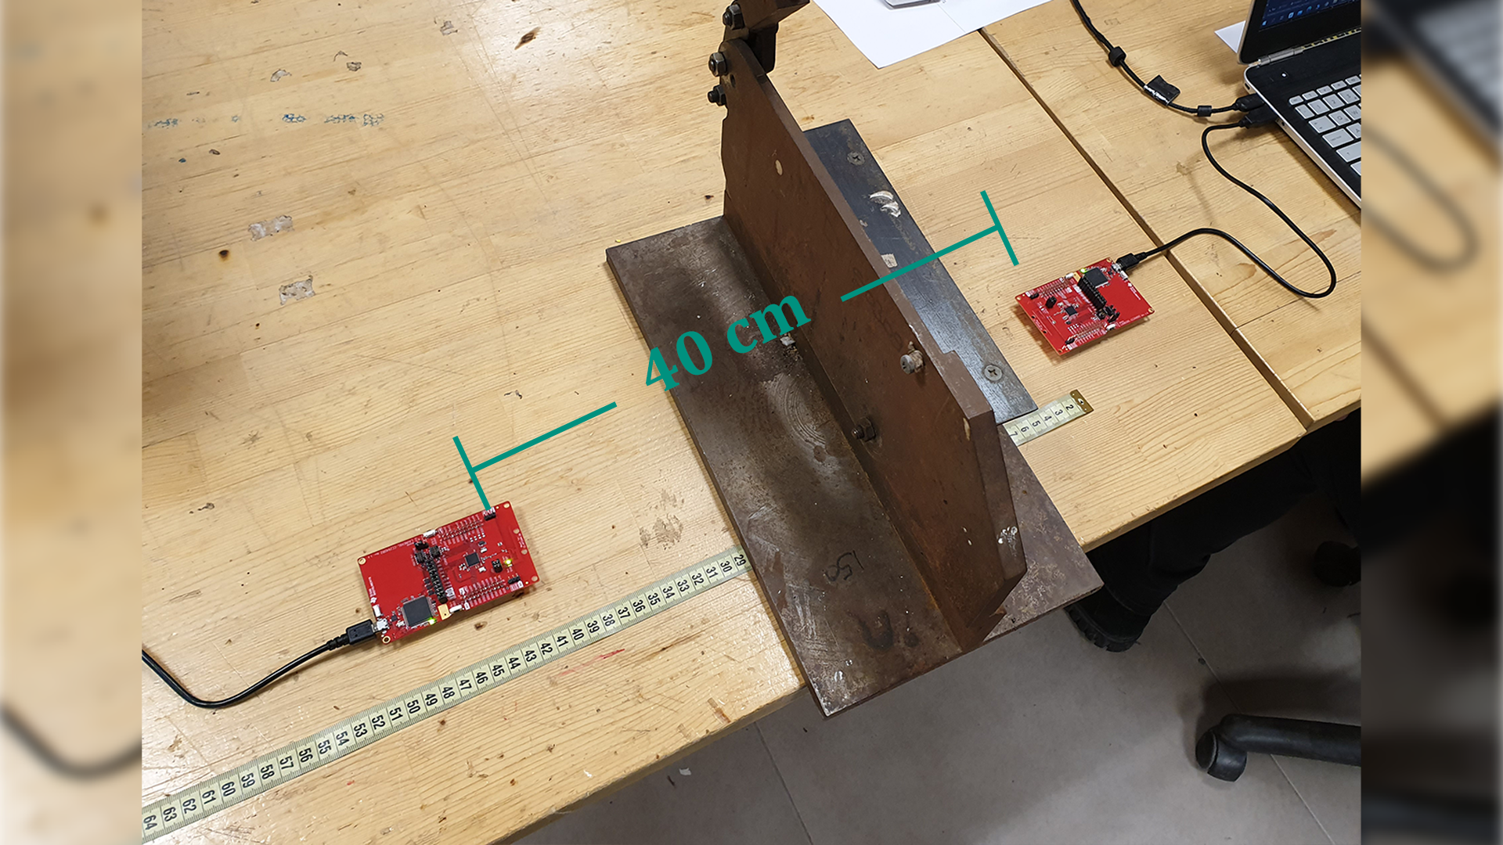
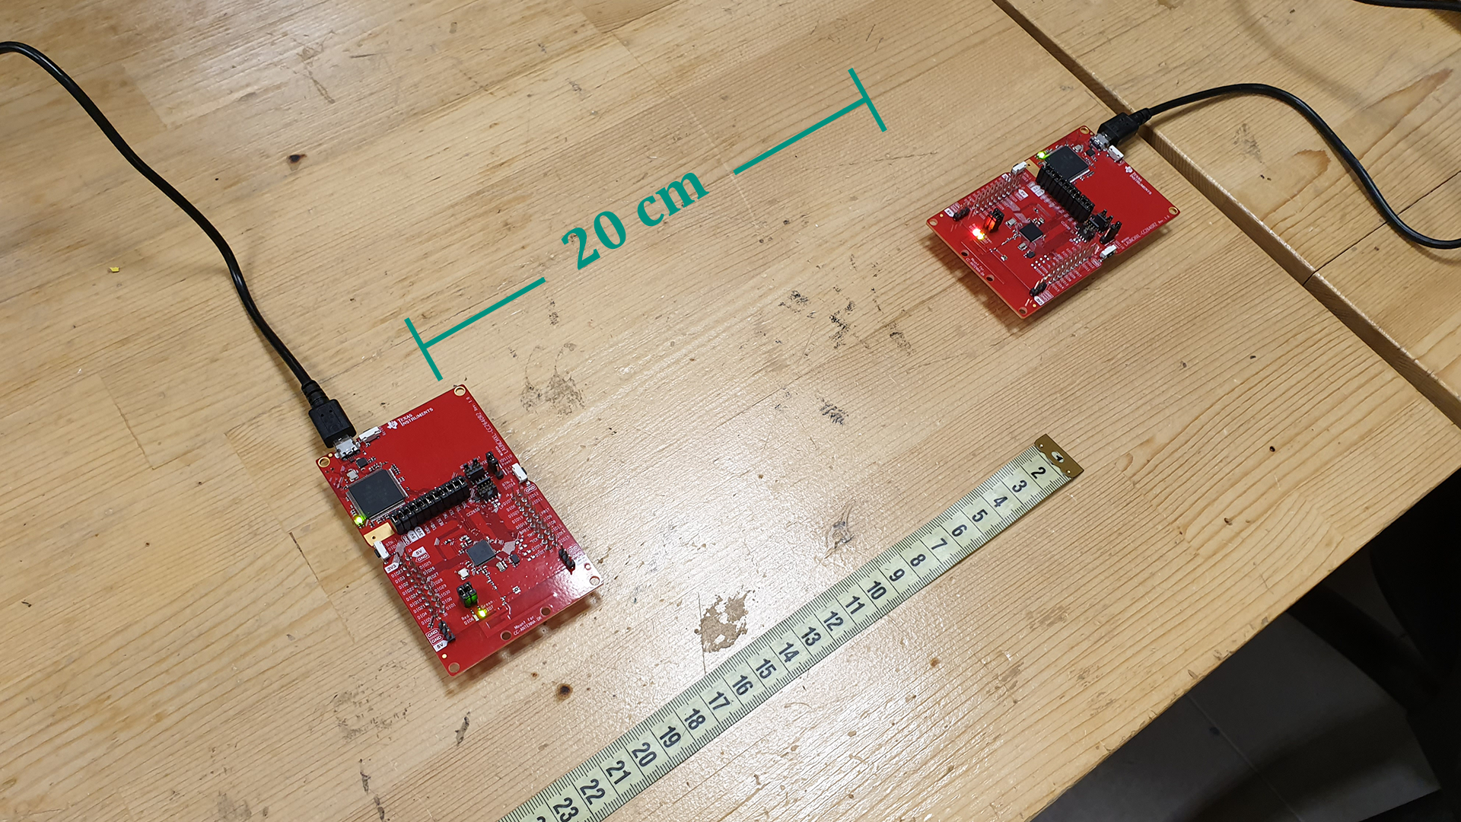
Figure 6: Photos of the test cases

Slide 28
Test Results
 | Mean RSSI (dBm) |  |  |  |  | Standard Deviation of RSSI (dBm)
Distances | 20 cm | 40 cm | 60 cm | 80 cm | 100 cm | 20 cm | 40 cm | 60 cm | 80 cm | 100 cm
Control (Filtered) | -27.96 | -31.41 | -37.46 | -38.19 | -45.05 | 0.034 | 0.187 | 0.404 | 0.206 | 0.749
Obstruction:Chipboard | -26.60 | -29.37 | -31.17 | -34.01 | -49.15 | 0.107 | 0.088 | 0.258 | 0.031 | 0.176
Obstruction:Metal Object | -41.26 | -35.01 | -49.45 | -48.32 | -46.65 | 0.314 | 0.509 | 1.532 | 3.64 | 0.318
90° Angled | -33.90 | -37.90 | -46.04 | -51.57 | -44.24 | 0.532 | 0.559 | 1.17 | 0.717 | 0.548
180° Angled | -27.71 | -33.85 | -36.95 | -39.91 | -37.79 | 0.090 | 0.131 | 0.107 | 0.127 | 0.197
Control (Raw) | -30.64 | -33.83 | -34.40 | -37.71 | -43.52 | 0.520 | 0.425 | 0.616 | 0.475 | 0.842

Slide 29
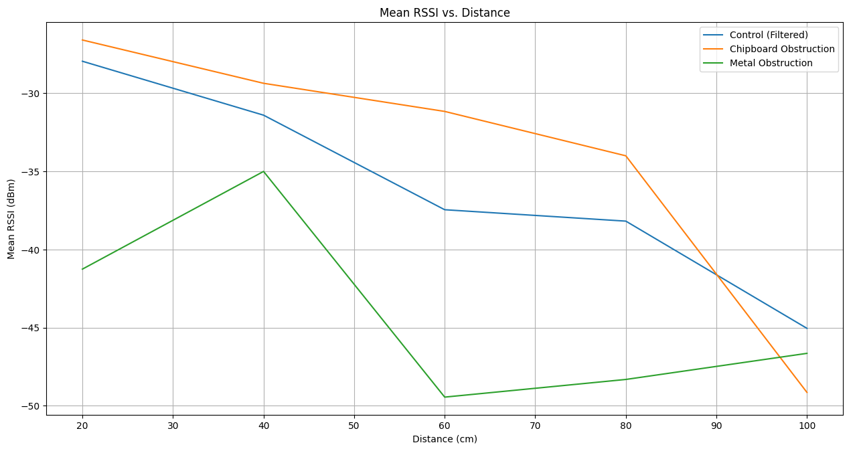
Test Results
Figure 7: Mean RSSI vs. Distance plot for 3 cases

Slide 30
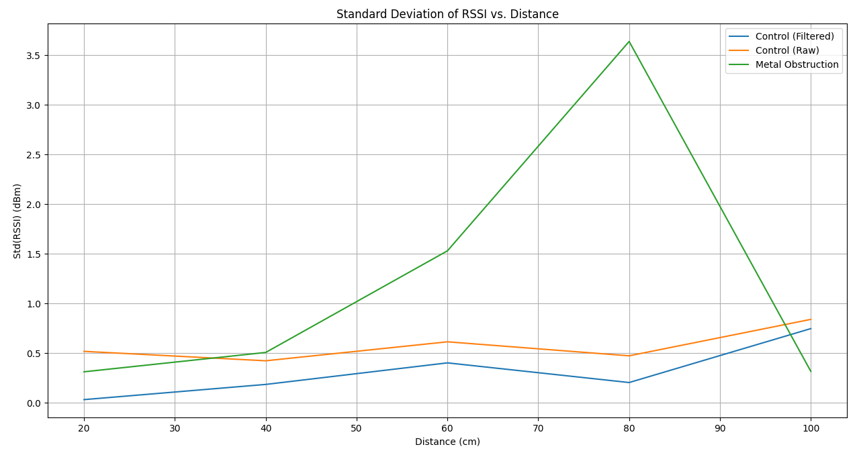
Test Results
Figure 8: Standard Deviation of RSSI vs. Distance plot for 3 cases

Slide 31
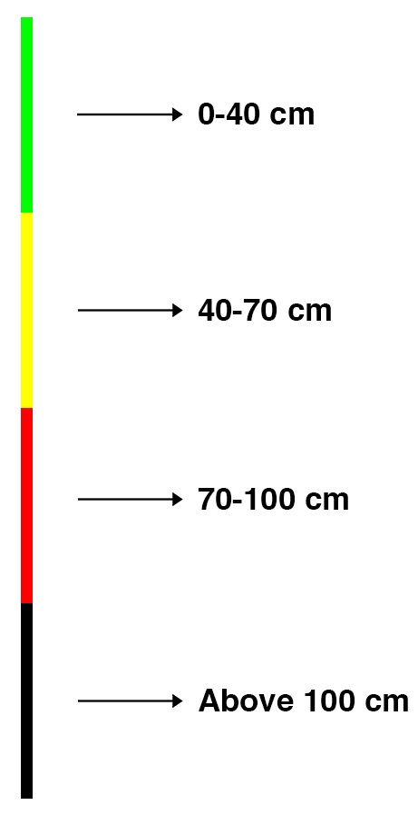
Test Results
Set Threshold Distance (cm) | Measured Threshold Distance (cm) | Absolute Error (%)
40 | 48 | 20
70 | 76 | 8.57
100 | 98 | 2
Figure 9: Distance estimation parameters theoretical vs. measured

Slide 32

Management
Cost Analysis
Deliverables
Gantt Chart

Slide 33
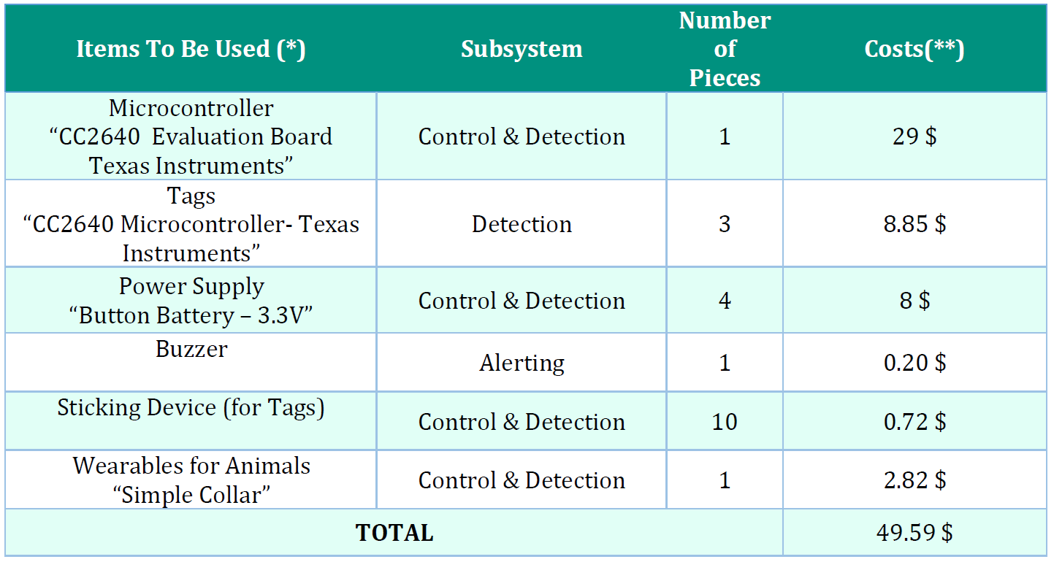
Cost Analysis
(*) (Expected Items) The equipment examined and used here may change according to our future research and test results. There may be some materials that can be used as extra or removed from there.
(**) Pricing is based on the known market value of the components (Robotistan, Alibaba, etc.). It may change according to the incoming hikes or discounts.

Slide 34
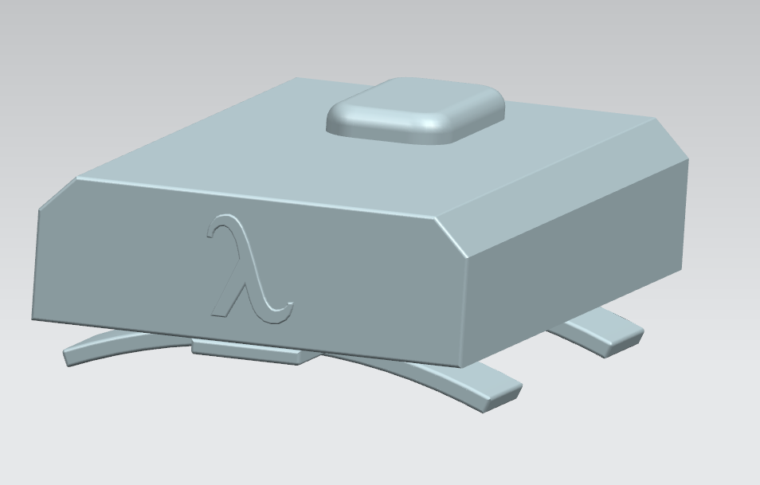
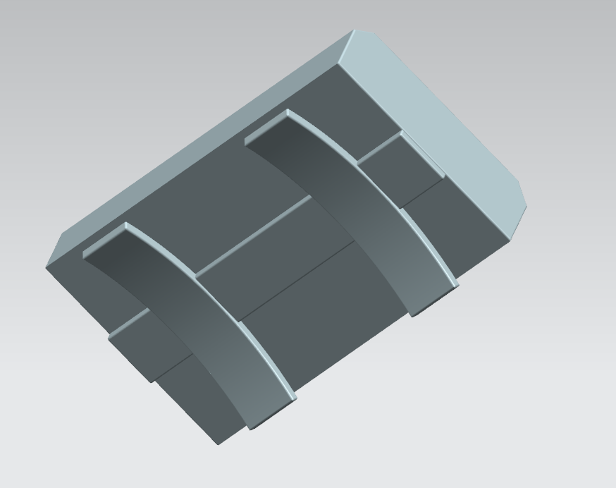
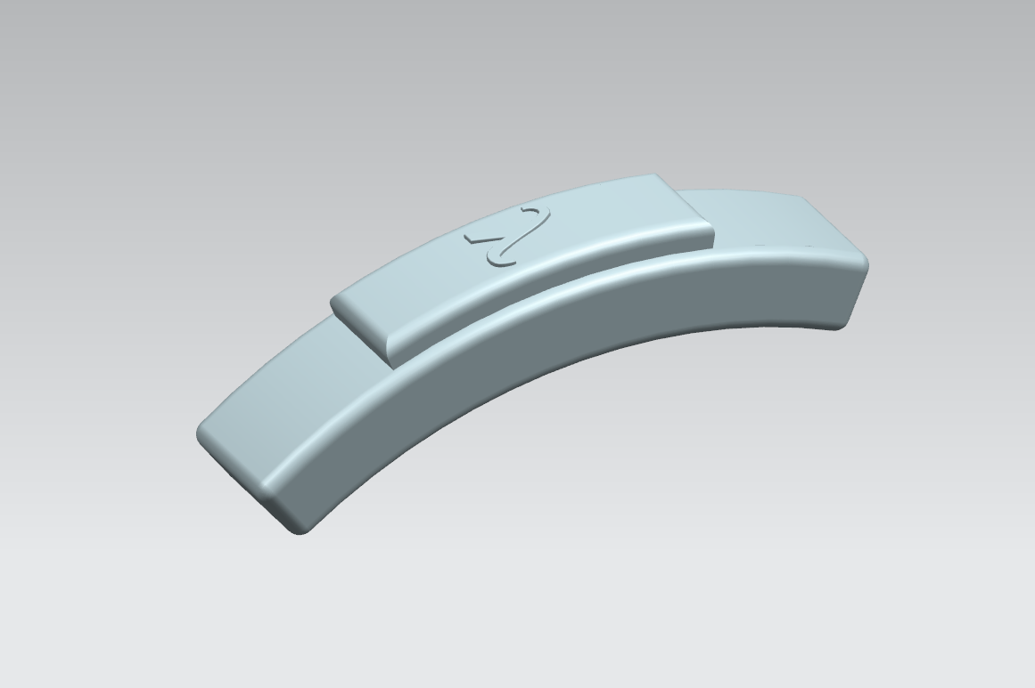
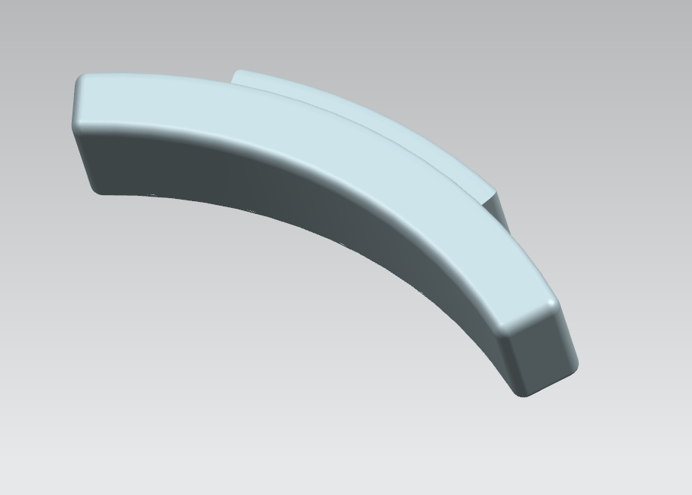
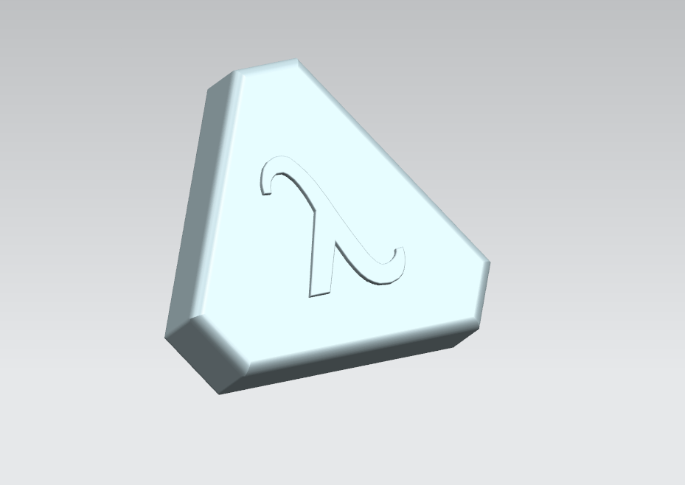
Deliverables
Equipment Deliverables
Master Unit
Master unit has a structure suitable for the average size of the pet.
Tag
Tags that the customer will place in the desired part of the house
Figure 10: First Concept 3D Model of the Master Unit
Figure 11: Second Concept 3D Model of the Master Unit
Figure 12: Concept 3D Model of the tag

Slide 35

Deliverables
Service and Technical Hardware Support
Warranty Certificate
The device will be guaranteed by Lambda Company for two years.
User Manual
A user-friendly document stating the device's initial setup recommended usage patterns and modes.

Slide 36
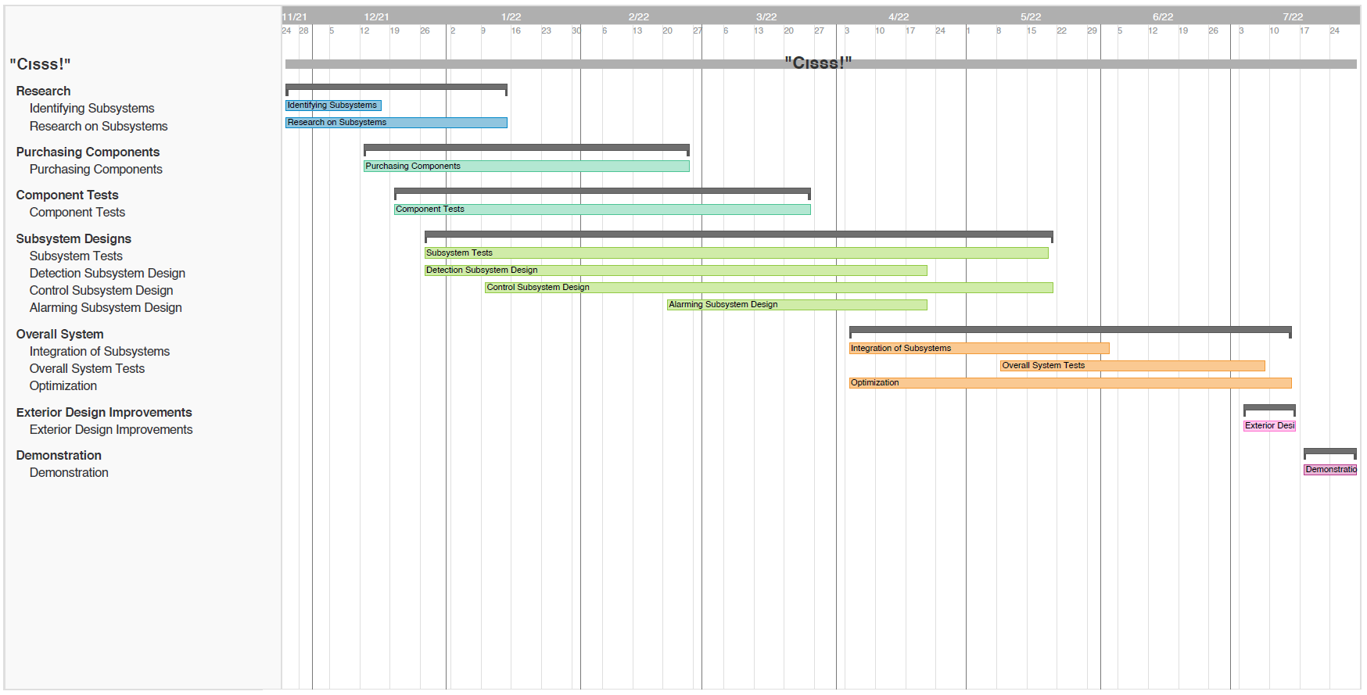
Gantt Chart

Slide 37




Conclusion
Lambda has introduced you the its unique project “Cıss!”

Slide 38
Thanks for Listening
Company Lambda

